Slide 1



Slide 2







Slide 3





Slide 4


Slide 5


Slide 6


Slide 7



-
-
-

Slide 9





Slide 10







Slide 11





Slide 12























Slide 13


Slide 14




Slide 15



Slide 17







Slide 18


Slide 19



Slide 20









Slide 21



Slide 22






Slide 23







-
-

Slide 24

public interface Engine {
void start();
void stop();
}

Slide 25



public abstract class Car { private Engine engine; public void drive() {
engine.start();
// ....
}
public abstract void accelerate();
}

Slide 26




Slide 27

public abstract class Car { private Engine engine;
// ....
public setEngine(Engine engine) {
// ....
}
}

Slide 28
public class Car { // .... public void checkEngine() | { | class EngineChecker { public void checkEngine() // .... | {
// .... |  | }
} |  | }
}

Slide 29
public class Car {
// ....
public void setCheckEngine(EngineChecker ec) {
// ....
}
}

Slide 30


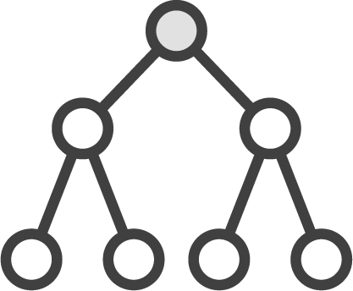



-
-
-
-

Slide 31
class EngineChecker {
// ....
public checkEngine() {
// ....
}
}
class FourCylinderEngineChecker
extends EngineChecker {
public checkEngine() {
// Redefine method
}
}
class V6EngineChecker
extends EngineChecker {
public checkEngine() {
// Redefine method
}
}

Slide 32



Slide 33
Engine engineChecker1 = new EngineChecker();
Engine engineChecker2 = new V6EngineChecker();
// Call V6EngineChecker’s method
engineCheker2.checkEngine();

Slide 34


Slide 35


Slide 36
















Slide 37







Slide 38









Slide 39




Slide 40


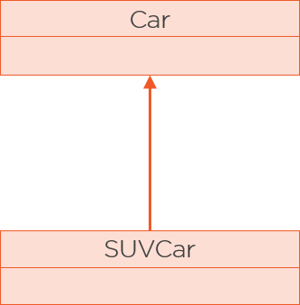



Slide 41



Slide 42


Slide 43





Slide 44



Slide 45








-

Slide 46


Slide 47






-
-
-

Slide 48






Slide 49




Slide 50




Slide 51



-
-

Slide 52




Slide 53







Slide 54






-
-
-

Slide 55





-
-
-
-

Slide 56













-
•
•
•
•
•
-
•
•
•
•

Slide 57



-
•
•
•
-
•
•

